Slide 1
Dashboard Blueprint
Team 3

Slide 2
Electric vs. Manual Bikes
As a team, we are considering a bike share business. We want to know if electric or manual bikes would be more popular among user.
To do this we take a sample datasource from CitiBike and perform our analysis.

Slide 3
Final Dashboard Tools
The tools we will use to create the final dashboard will be Tableau.
Tableau is a visual analytics platform that transforms data into an engaging story for any audience.

Slide 4
Interactive Elements
Pie chart
Bar Chart

Slide 5

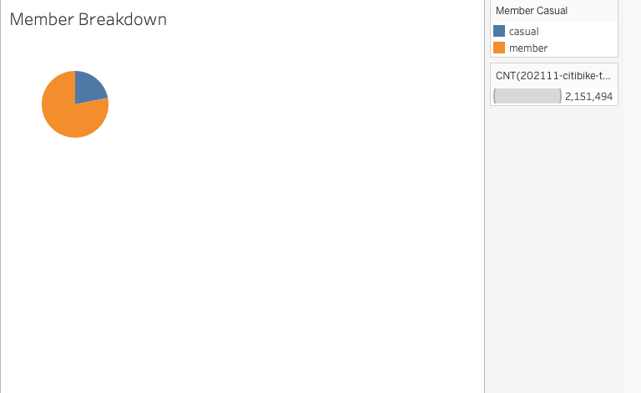
Images from initial analysis

Slide 6
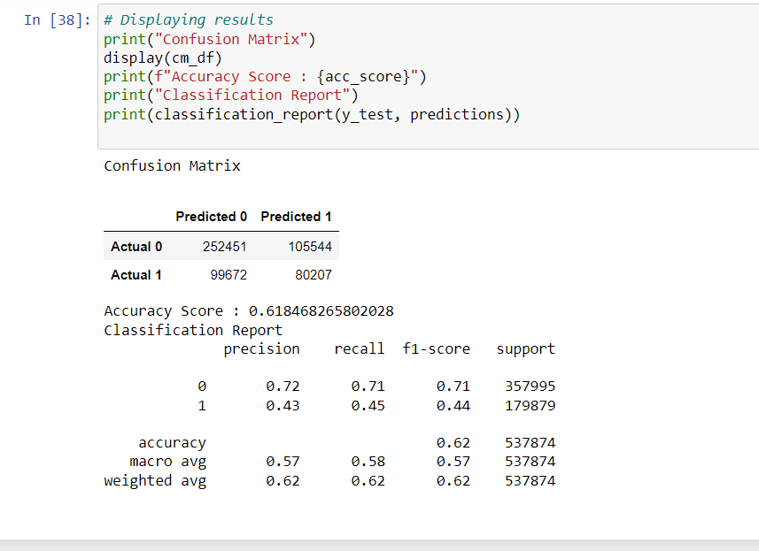
Data from the Machine Learning Task

Slide 7
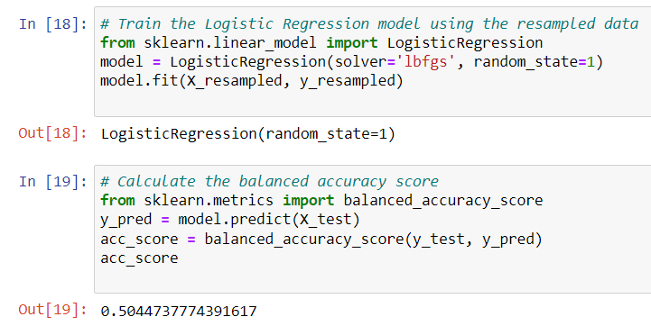

Slide 8
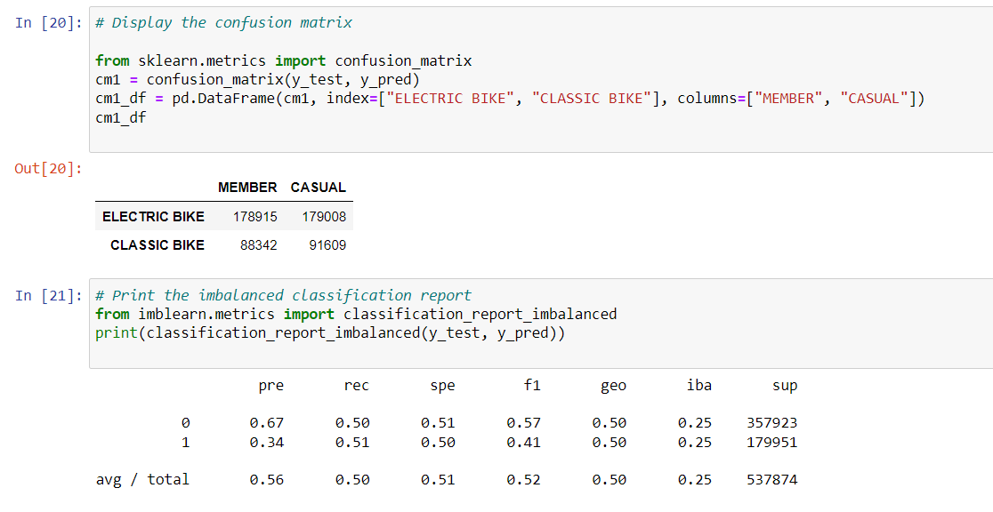

Slide 9
Interactive Element
[Paige’s tableau link]

